Slide 1
Linguistic Regularities in Continuous Space Word Representations
embedding表示的语言规律
King -Man + Woman=Queen

Slide 2
n-gram language models
1、word序列：P(（“我”,“司”,“可”,“办理”,“正规发票”)|S)
2、假设性独立：P(“我”)P(“司”)P(“可”)P(“办理”)P(“正规发票”)
.
3、链式规则：P(x1)P(x2|x1)P(x3|x1,x2)...P(xn|x1,x2,...,xn−1)
4、n-gram语言模型: P(x1)P(x2|x1)P(x3|x2)P(x4|x3)..P(x10|x9)
2-gram: P(x1)P(x2|x1)P(x3|x2)P(x4|x3)..P(x10|x9)
(1) a n-gram model works in terms of discrete units that have no inherent relationship to one another

Slide 3
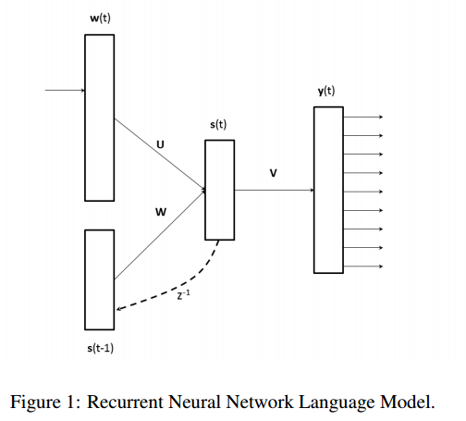
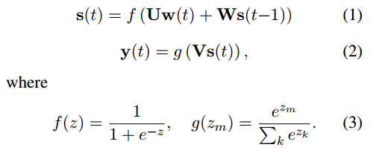

Slide 4

we created a test set of analogy questions of the form “a is to b as c is to _”
(1) base/comparative/superlative forms of adjectives;
(2) singular/plural forms of common nouns;
(3) possessive/non-possessive forms of common nouns;
(4) base, past and 3rd person present tense forms of verbs

Slide 5

We used the SemEval-2012 Task 2, Measuring Relation Similarity
For example, take the ClassInclusion:Singular Collective relation with the prototypical word pair clothing:shirt. To measure the degree that a target word pair dish:bowl has the same relation, we form the analogy “clothing is to shirt as dish is to bowl”

Slide 6


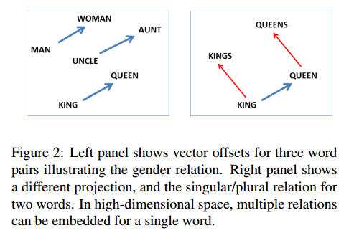
Analogy question a:b c:d where d is unknown

Slide 7
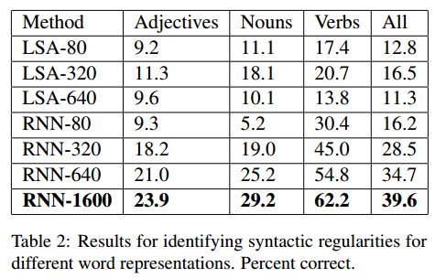

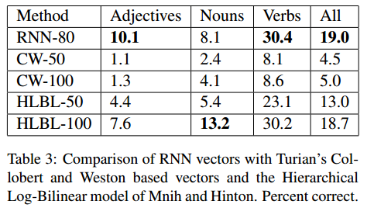


syntactic relations test
The systems were trained with 320M words of Broadcast News data as described in (Mikolov et al., 2011a),
and had an 82k vocabulary
LSA（Latent Semantic Analysis）:将秩r的词项-文档矩阵C进行SVD分解，并寻求词项-文档矩阵的k秩逼近Ck (k<=r)
CW(SENNA):
X 为训练集中的所有连续的 n 元短语，D 是整个字典
M&H (HLBL):

Slide 8
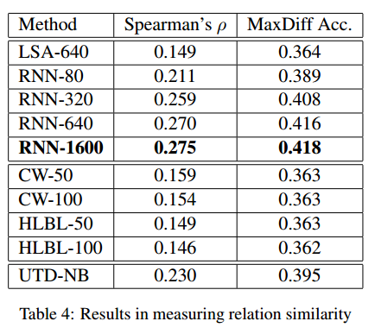
Semantic relations test
These representations were trained on 37M words of data
斯皮尔曼等级相关系数:用来估计两个变量X、Y之间的相关性
MaxDiff accuracy:以最小的代价来评估A、B、C、D序列的排序

Slide 9
Thanks !

Slide 10
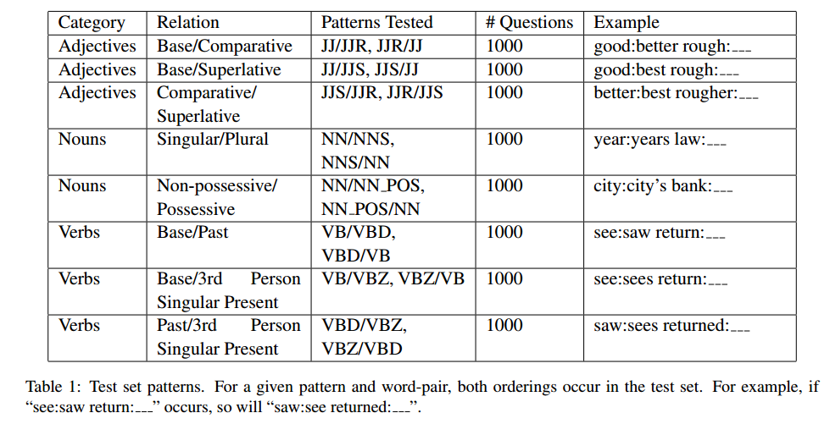
syntactic relations test data
The total test set size is 8000

Slide 11


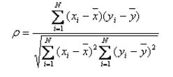

Spearman Rank(斯皮尔曼等级)相关系数
两个随机变量分别为X、Y（也可以看做两个集合），元素个数均为N，两个随即变量取的第i（1<=i<=N）个值分别用Xi、Yi表示。对X、Y进行排序（同时为升序或降序），得到两个元素排行集合x、y，其中元素xi、yi分别为Xi在X中的排行以及Yi在Y中的排行。将集合x、y中的元素对应相减得到一个排行差分集合d，其中di=xi-yi，1<=i<=N。随机变量X、Y之间的斯皮尔曼等级相关系数可以由x、y或者d计算得到，其计算方式如下所示:

Slide 12
MaxDiff accuracy
http://bbs.pinggu.org/thread-5082350-1-1.html
LSA
http://blog.csdn.net/cang_sheng_ta_ge/article/details/46708515
CW HLBL
http://licstar.net/archives/328

